Slide 1

Software Engineering Principles
e-Compiler
Team Sankalan

Slide 2
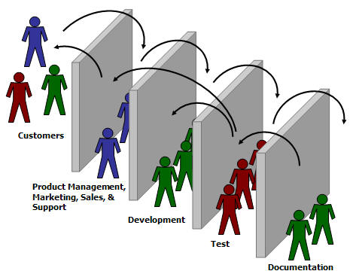
The Model Used
Agile Model with Iterative Incremental Development Principles.

Slide 3
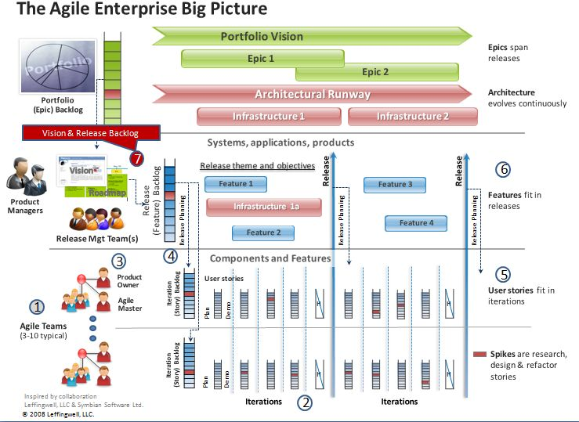

Slide 4
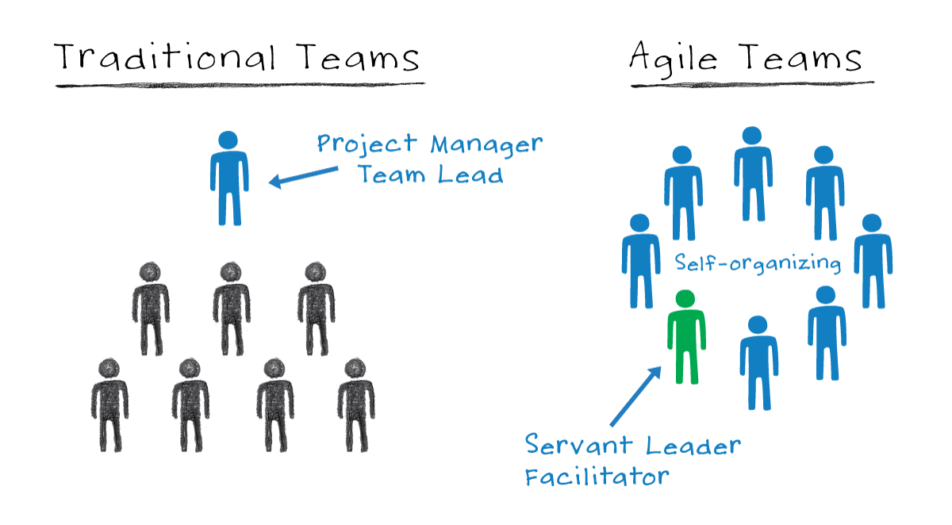
Type Of Organisation
Agile Team: Self-organising,cross-functional team.

Slide 5
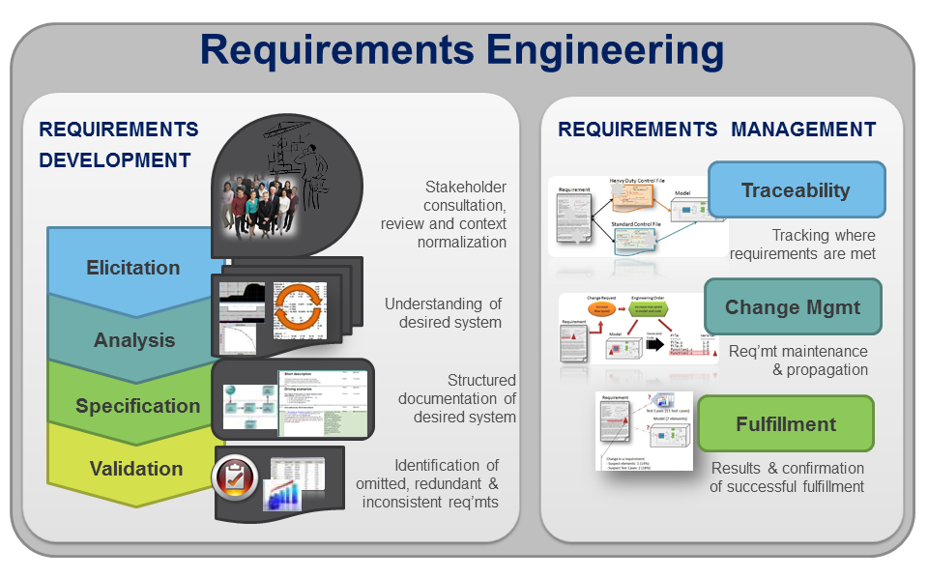
Requirements Engineering

Slide 6



Elicitation
Survey.

Slide 7


Requirements Analysis
Brainstorming.

Slide 8
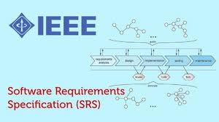
Software Requirements Specification
Deliverable : SPEC Document

Slide 9


Requirements Validation
SPEC Review.
Deliverable : SRS Checklist

Slide 10

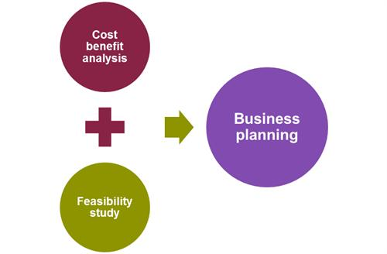
Analysis and Project planning
Cost estimation
Scheduling
Feasibility Analysis
Deliverable : Feasibility Report

Slide 11
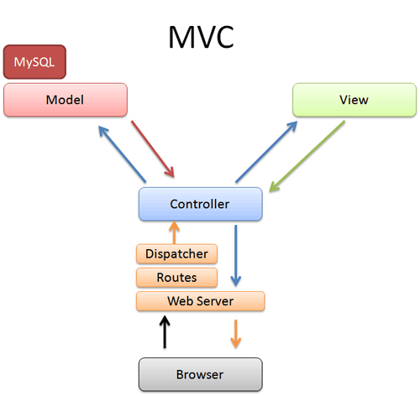
Product Design
Model View Controller(MVC) Model.
Deliverable: The Design Document

Slide 12

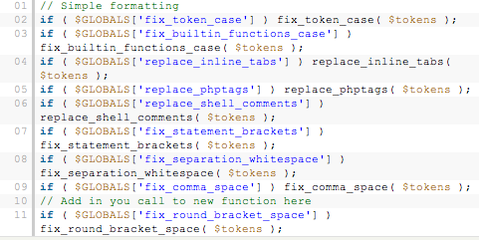
Implementation
GUI
Business Logic
Database Management
Deliverable:
Source Code
Self Review Report
Code Review

Slide 13
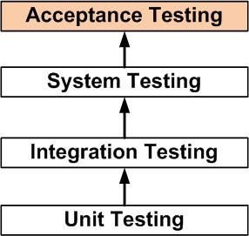
Testing
Unit Testing
Integration Testing
Acceptance Testing
User authentication testing(Navigation testing)
Product verification and validation
Deliverable : Test Report

Slide 14

Thank YOU!

